Slide 1

Data Mining Group Project
ISM 6136 Data Mining Fall 2016
By
Aravind Reddy Meenige
Mothiki Krishna Mallik

Slide 2
Health Insurance Marketplace:
The data set is public and is available in https://www.healthcare.gov/ as well as https://www.kaggle.com/hhs/health-insurance-marketplace
The data belongs to Affordable Care Act also known as Obama Care which is managed by U.S. centers for Medicare and Medicaid Services.
The data dictionaries are available in https://www.cms.gov/cciio/resources/data-resources/marketplace-puf.html
The link to the video created by us describing the complete project in detail https://youtu.be/zMemqKBuYao

Slide 3
We have six datasets in total consisting of Data from 2014 to 2016:
Benefits and Cost sharing:
It consists of approximately 5 Million records of plan level data on essential health benefits, coverage limits and cost sharing for each plan.
It includes parameters such as Business year, State code, Issuer Id, Plan Id, Benefit Name, Coinsurance in Network, Coinsurance out of Network, Copay in Network, Copay out of Network, is an Essential Health Benefit, is a State Mandated benefit, Is the benefit covered and Is there a quantitative limit on the Service.
Rate:
It consists of approximately 12 Million records of plan level data on Individual rates based on age, tobacco use and geographical location of eligible subscribers.
It includes parameters such as Business year, State code, Issuer Id, Plan Id, Rating Area Id, Tobacco Use, Age, Individual Rate and Individual Tobacco Rate.

Slide 4
Plan Attributes:
It consists of approximately 77 K records of plan level data on maximum out of pocket payments, deductibles, cost sharing, eligibility of Health Savings account and other plan attributes.
It includes parameters such as Business year, State code, Issuer Id, Market coverage and Standard Component Id.
Business Rules:
It consists of approximately 21 K records of plan level data on the application of rates.
It includes parameters such as Business Year, State code, Issuer Id, Dependent Maximum Age rule, Children only contract max children rule, Age determination rule and minimum tobacco free months’ rule.
Service Area Id:
It consists of approximately 0.4 Million records of issuer level data on the geographical coverage.
It includes parameters such as Business year, State code, Issuer Id, Service area Id, Will the service cover entire state and Is the service a dental plan only.
Network:
It consists of approximately 3800 records of issuer level data identifying the provider network details.
It includes parameters such as Business year, State code, Issuer Id, Network name, Network Id, Market coverage and Is the service a dental plan only.

Slide 5

Important Terminology:
The health benefits coming under the below categories were classified as Essential health benefits:

Slide 6
Co-insurance is the percentage of amount to be paid after a fixed deductible amount whereas Co-pay is the fixed amount charge payable.
Out of pocket limit is the maximum amount of money that an individual has to pay irrespective of the values of deductibles, copayments and coinsurance.
There are four levels of coverage depending on the auctorial value of the plan:
Bronze – Covers up to 60% of the cost on average.
Silver – Covers up to 70% of the cost on average.
Gold – Covers up to 80% of the cost on average.
Platinum – Covers up to 90% of the cost on average.
If a state requires benefits that exceed those included in the essential health benefits package, then the state has to pay the cost of these additional mandated benefits.

Slide 7
Finding out the target variable:
Our analysis is completely dependent upon plans within the state of Florida.
We would like to create a binomial target variable which decides the credibility of a plan based on the average rate of the plan and number of benefits within the plan.
Then, we will try to find out a relationship between the target variable and other important parameters such as Business year, Plan Id, Issuer Id, Number of Benefits, Number of benefits covered by the issuer within Florida state, Number of essential health benefits, number of benefits mandated by the state, Number of benefits with quantitative limit and the average rate of premium for the health insurance plan.
For this, we require two datasets, Benefits Cost Sharing and Rate.
As the data contains millions of records, we used R Studio to clean the data sets.
We separated corresponding attributes from the data sets and finally extracted 1021 rows of required data.

Slide 8
R- Code implemented to obtain the Final dataset:
#Include all the required libraries
library(xlsx)
library(sqldf)
library(tidyr)
library(dplyr)
#Locate files and input them as corresponding datasets
BenefitsCostSharing = read.delim(file.choose(), sep=",", stringsAsFactors=FALSE, na.strings="")
Rate = read.delim(file.choose(), sep=",", stringsAsFactors=FALSE, na.strings="")
#Select the columns which are important to us
DemoBCS <- BenefitsCostSharing[,c(1,2,13,14,17,20,26,29,30)]
DemoRate <- Rate[,c(1,2,3,11,15)]
#Change the clumn name of Standard component ID to Plan ID
colnames(DemoBCS)[8] <- "PlanId"

Slide 9
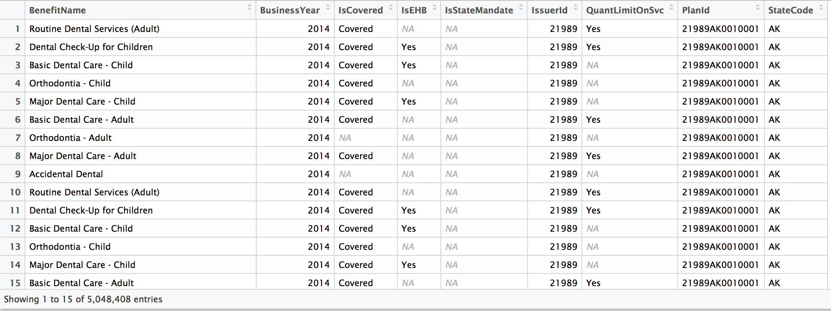
Below is the image which depicts the Benefits cost sharing dataset after extracting required attributes:

Slide 10
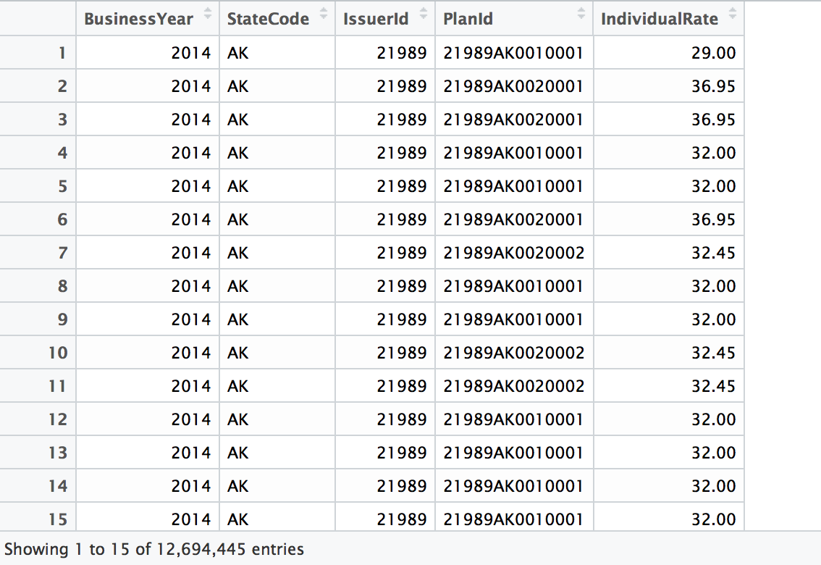
Below is the image which depicts the Rate dataset after extracting required attribute:

Slide 11
As we can see from the above images that there are a lot of null values in the attributes such as IsCovered, IsEHB, and IsStateMandate.
As per the data dictionaries, we can fill the null values with “no” or “not covered” depending on the attribute.
For feasibility, let us also convert the attributes IsCovered, IsEHB, IsStateMandate and QuantLimitOnSVC to binary variables with “Yes” or “Covered” as 1 and “no” or “not covered” as 0.
#As mentioned, locate all NA values and convert them to zero
DemoBCS[is.na(DemoBCS)] <- 0
DemoRate[is.na(DemoRate)] <- 0

Slide 12
#Categorize the variables to binomial
DemoBCS$IsCovered[which(DemoBCS$IsCovered=="Covered")] <- 1
DemoBCS$IsCovered[which(!(DemoBCS$IsCovered==1))] <- 0
DemoBCS$IsEHB[which(DemoBCS$IsEHB=="Yes")] <- 1
DemoBCS$IsEHB[which(!(DemoBCS$IsEHB==1))] <- 0
DemoBCS$IsStateMandate[which(DemoBCS$IsStateMandate=="Yes")] <- 1
DemoBCS$IsStateMandate[which(!(DemoBCS$IsStateMandate==1))] <- 0
DemoBCS$QuantLimitOnSvc[which(DemoBCS$QuantLimitOnSvc=="Yes")] <- 1
DemoBCS$QuantLimitOnSvc[which(!(DemoBCS$QuantLimitOnSvc==1))] <- 0

Slide 13
Write Sql codes to extract required data from both the datasets, DemoBCS and DemoRate:
#Verify the column names
colnames(DemoBCS)
colnames(DemoRate)
#Select and calculate required columns from Rate, corresponding to Florida state
FinalRate <- sqldf("Select BusinessYear, IssuerId, PlanId, avg(IndividualRate) ,
from DemoRate where StateCode = 'FL' group by PlanId
")
#Select and calculate required columns from BenefitsCostSharing, corresponding to Florida state
FinalBCS <- sqldf("Select BusinessYear, IssuerId, PlanId, count(BenefitName), sum(IsCovered), sum(IsEHB) ,
sum(IsStateMandate), sum(QuantLimitOnSvc) from DemoBCS where StateCode = 'FL'
group by PlanId, IssuerId")
#Check the column names and edit them to our feasibility
colnames(FinalBCS)
colnames(FinalRate)

Slide 14
colnames(FinalBCS) <- c("BusinessYear","IssuerId","PlanId","NoOfBenefits","NoOfBenefitsCovered",
"NoOfEHBs","NoOfStateMandates","NoOfBenefitsWithQuantLimit")
colnames(FinalRate) <- c("BusinessYear","IssuerId","PlanId","AverageRate")
Implement inner join on both the data sets and export it as an excel file.
#Join both the tables and create the final table required for our prediction
final <- sqldf("Select db.businessyear,db.issuerid,db.planid,
db.NoOfBenefits, db.NoOfBenefitsCovered,db.NoOfEHBs, db.NoOfStateMandates,db.NoOfBenefitsWithQuantLimit,
dr.AverageRate
from FinalBCS db inner join FinalRate dr
on dr.planid = db.planid and
dr.issuerid = db.issuerid
")
#Save the final table to local disk
write.xlsx(final, "/Users/mothiki/Downloads/FinalDMProj.xlsx")

Slide 15
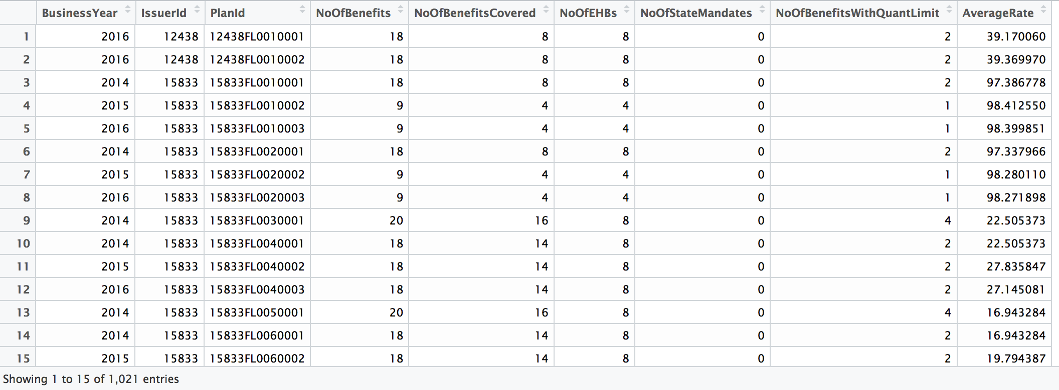
Below image depicts the final dataset obtained after the cleansing process:

Slide 16
Create a target variable using the formula:
Target= IF(AND((E2>= (0.66) *357.2399608), (J2<= (1.33) *387.1721903)),1,0)
Average Number of benefits = 357.2399608
Average Rate = 387.1721903
We assumed that the threshold value for number of benefits for the plan to be considered as optimum is 66% of the average and the threshold value for average rate of plan for the plan to be considered optimum is 33% above the average.
Optimum values are considered as 1 and plans that are not recommendable are considered as 0.
Notes:
We have created a binomial target variable which decides the credibility of a plan based on the average rate of the plan and number of benefits within the plan.
Then, we will try to find out a relationship between the target variable and other important parameters such as Business year, Plan Id, Issuer Id, Number of Benefits, Number of benefits covered by the issuer within Florida state, Number of essential health benefits, number of benefits mandated by the state, Number of benefits with quantitative limit and the average rate of premium for the health insurance plan.

Slide 17
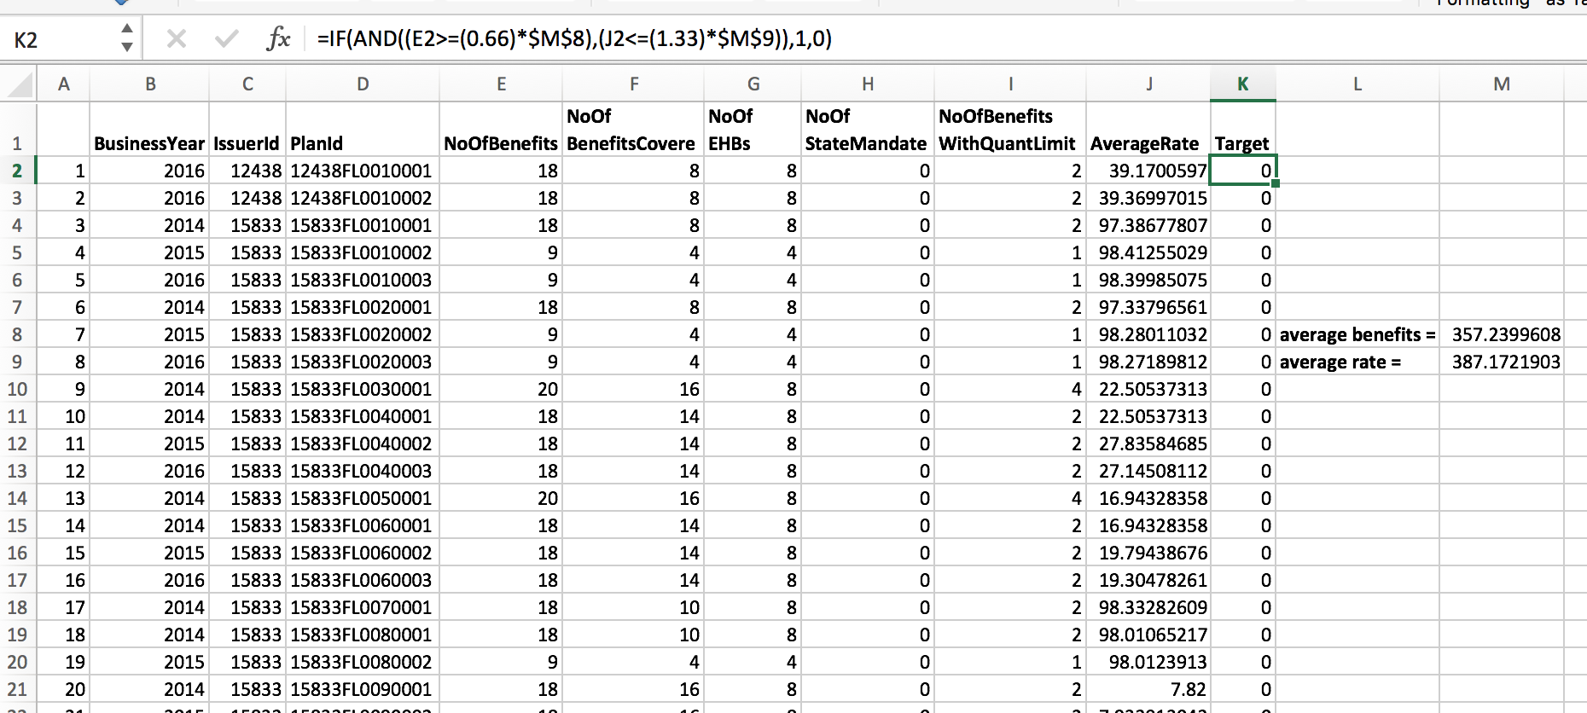
Save this dataset as a CSV file and import it into SAS Enterprise miner to proceed with predictions.

Slide 18
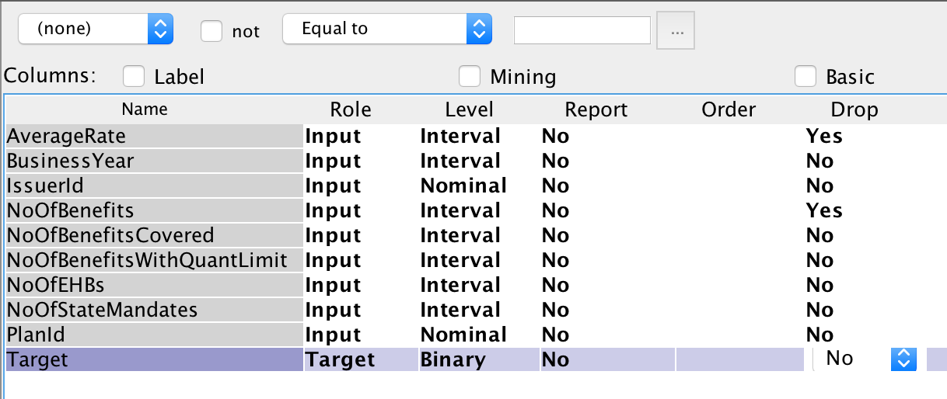
Create a new project in SAS Enterprise miner. Add a diagram with the project name where we can build the models.
Import the dataset using file import, select the target variable, change the level of required variables and drop number of benefits and average age which are used to calculate target variable. The modifications must look like the screenshot given below:

Slide 19
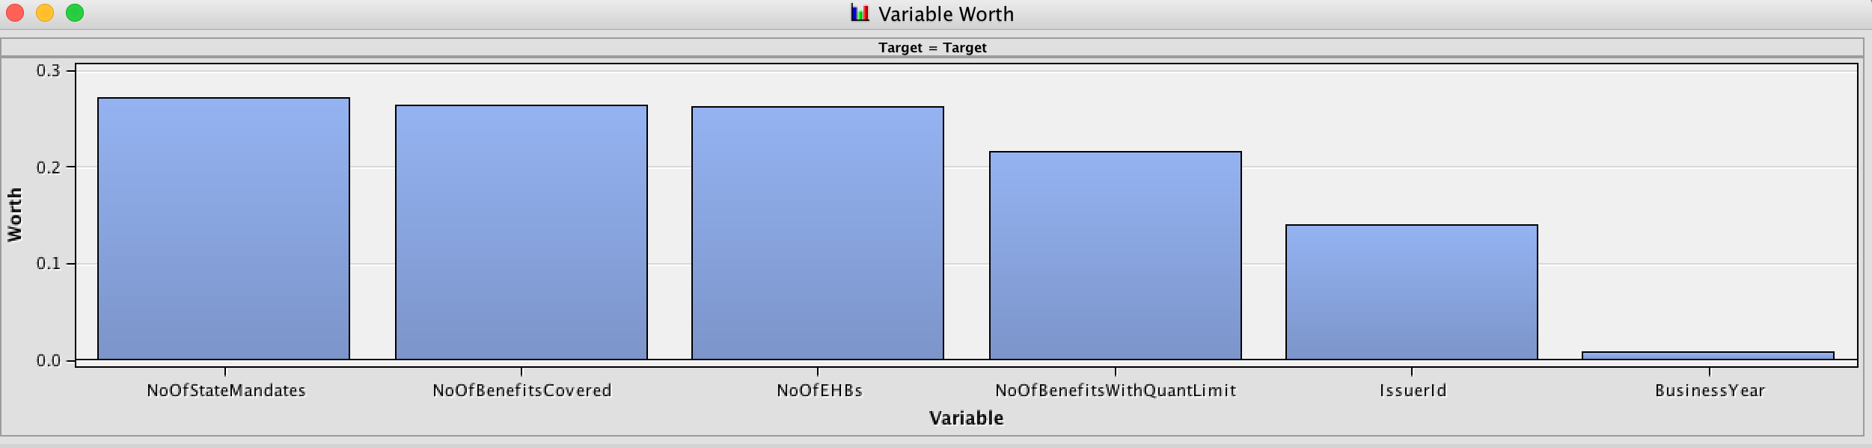
Using stat explore functionality we can find out the worth of all the attributes. The below graph gives a graphical representation of the importance of all the variables:
Add data partition functionality in order to separate the dataset into training and testing datasets. Allocate 70% for training, 20% for validation and 10% for testing.
Add control point which can be used to implement various algorithms using the same flow of diagrams.

Slide 20
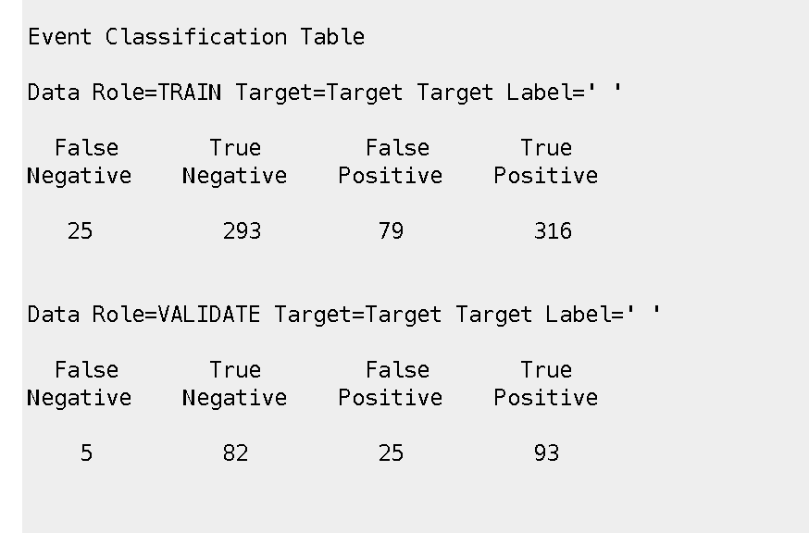
As the first method of prediction, let us implement Decision tree algorithm.
Below image contains the Event classification table from which the accuracy can be calculated which is 85.4%

Slide 21
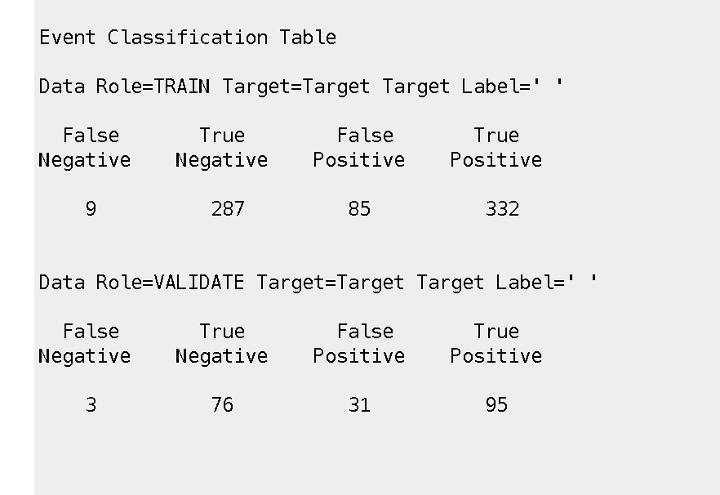
Let us predict using other models like Neural Networks and Naive Bayes algorithms.
Neural Network:
Accuracy: 86.1%
Below is the classification table when the prediction is made using Neural Network.

Slide 22
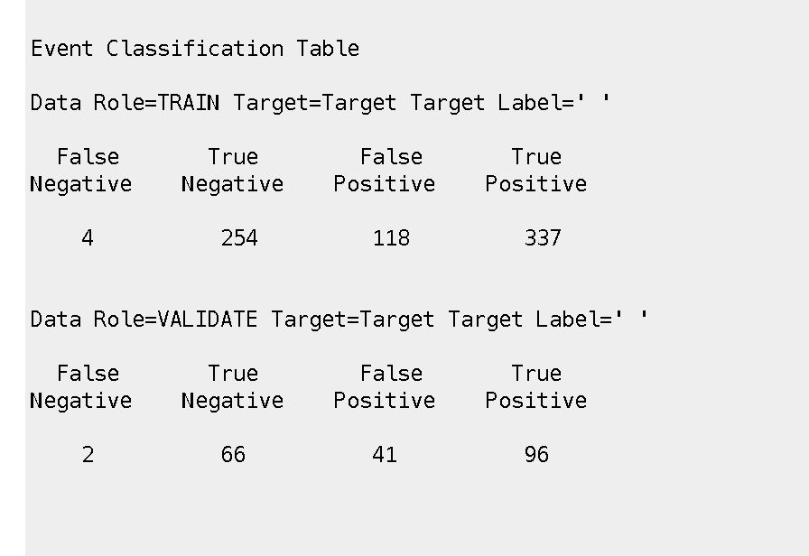
Naïve Bayes:
Accuracy: 82%
Below is the classification table when the prediction is made using Naïve Bayes.

Slide 23
From the predictions and accuracies obtained, we can conclude that, for our dataset, Neural network gives the highest accuracy.
Let us change the training technique of Neural network from default to back propagation and check the accuracy.
Below image depicts the classification table when the prediction is made using Neural network with back propagation and the accuracy is 84.4% which is lesser compared to neural network with default training technique.
Hence, we recommend Neural network with default training technique as the best algorithm in predicting target variable for this dataset.

Slide 24
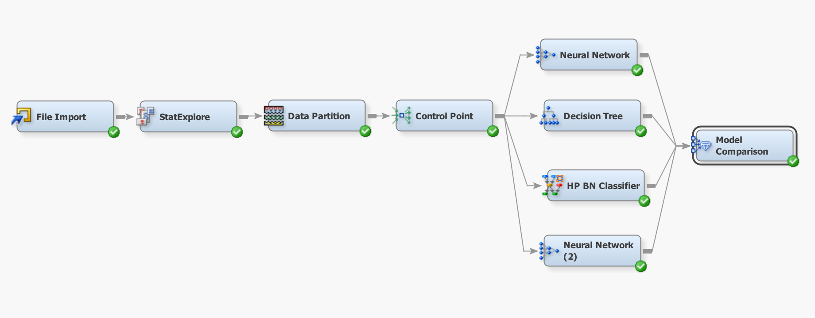
Below image shows us the complete diagram of the project in SAS Enterprise miner:

Slide 25
Conclusion for Part 1: Predictive analytics
Thus, from the finalized predictive model, we can identify if a plan comes under recommended plans category or not by knowing the parameters like, number of benefits covered, Number of Essential health benefits, Number of State mandated benefits and number of benefits with quantitative limit even though the total number of benefits and individual average rate of the plan is unknown.
Now that we have completed the predictive statistics, let us look at the Descriptive analytics for Health Insurance Marketplace data.
Notes:
Co-insurance is the percentage of amount to be paid after a fixed deductible amount whereas Co-pay is the fixed amount charge payable.
Out of pocket limit is the maximum amount of money that an individual has to pay irrespective of the values of deductibles, copayments and coinsurance.

Slide 26
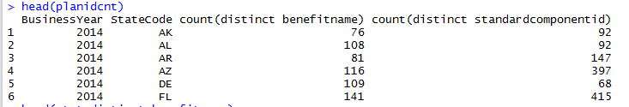
Dialysis Plans:
Benefits Cost Sharing:
Total Distinct benefits: 861
Total distinct benefits for year and for each state
For each state and year, Count of distinct benefits and count of distinct plans available.
For each business year, state, count of distinct plan id’s and count of distinct benefits.
Notes:
## to get distinct benefits avaliable till now
distnbenefitname <- sqldf("select distinct benefitname from BenefitsCostSharingtest ")
head(distnbenefitname)
## to get distinct benefts for each year
byrcntbenefitname <- sqldf("select businessyear, count(distinct benefitname) from BenefitsCostSharingtest group by businessyear")
head(byrcntbenefitname)
## to get distinct benefts for each year and for each state
statedistinctsbenefitname <- sqldf("select businessyear, statecode, count(distinct benefitname) from BenefitsCostSharingtest group by statecode, businessyear ")
head(statedistinctsbenefitname)
## For each state and year, Count of distinct benefits and count of distinct plans available.
planidcnt <- sqldf("select businessyear, statecode, count(distinct benefitname), count(distinct standardcomponentid) from BenefitsCostSharingtest
group by businessyear,statecode")
head(planidcnt)
------------------------------------------------------------------------------------------------------------------------------
planbenefits2 <- sqldf("select businessyear,statecode, planid, count(*) from BenefitsCostSharingtest group by businessyear,statecode, planid order by businessyear,statecode ")head(planbenefits2)
planbenefits <- sqldf("select businessyear,statecode, planid, count(ISCovered) from BenefitsCostSharingtest where IScovered = 'Covered' group by businessyear,statecode, planid order by businessyear,statecode ")
head(planbenefits)

Slide 27
Working on a particular benefit: Dialysis. Seeing the trend of the copay and Coinsurance.
65371 records are available for the benefit name dialysis
Considering the below columns:
Finding out the count of plan ID’s for different co-pay levels:
stat1 <- sqldf("select businessyear, statecode,copayInntier1, count(standardcomponentid) from benefitcostsharingdialysistest group by businessyear, statecode,copayInntier1")
stat3 <- sqldf("select businessyear, copayInntier1, count(standardcomponentid) from benefitcostsharingdialysistest group by businessyear,copayInntier1")
Finding out count of plan ID’s for different co Insurance levels
stat2 <- sqldf("select businessyear, statecode,CoinsInnTier1, count(standardcomponentid) from benefitcostsharingdialysistest group by businessyear, statecode,CoinsInnTier1")
stat4 <- sqldf("select businessyear,CoinsInnTier1,count(standardcomponentid) from benefitcostsharingdialysistest group by businessyear, CoinsInnTier1")
Notes:
Co-insurance is the percentage of amount to be paid after a fixed deductible amount whereas Co-pay is the fixed amount charge payable.
Out of pocket limit is the maximum amount of money that an individual has to pay irrespective of the values of deductibles, copayments and coinsurance.

Slide 28
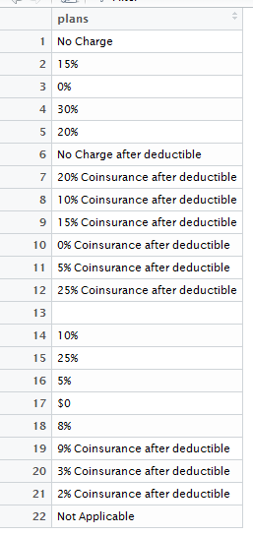
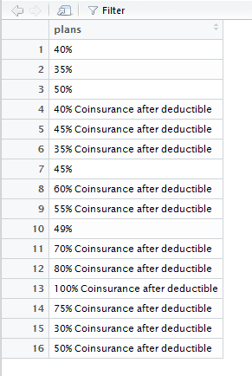
Good Plans:
: Bad Plans
Notes:
## bad plans analysisplans <- data.frame(unique(benefitcostsharingdialysis$CoinsInnTier1))
colnames(plans) <- "plans”
worstplans <- data.frame(plans[c(5,6,8,14,20,21,23,25,26,29,33,34,37,38,16,17),1])
colnames(worstplans) <- "plans"
goodplans <- data.frame(unique(benefitcostsharingdialysis$CoinsInnTier1))
colnames(goodplans) <- "plans”
goodplans <- sqldf("select * from goodplans where plans not in (select plans from worstplans)")
stat5forworst <- sqldf("select businessyear, statecode,CoinsInnTier1, count(standardcomponentid) from benefitcostsharingdialysistest where CoinsInnTier1 in (select plans from worstplans) group by businessyear, statecode,CoinsInnTier1 order by businessyear, statecode")
write.xlsx(stat5forworst,"A:/stat5forworst.xlsx")

Slide 29
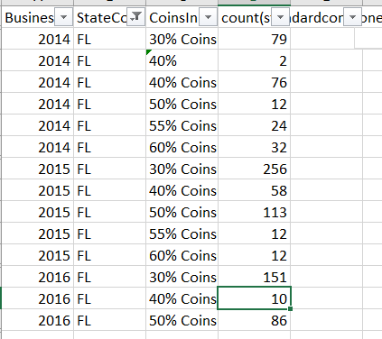
For Florida:
So till now we have discussed on how the Co Insurance levels are changing for the benefit dialysis, In the next slide we will be discussing on how the OuofPocketexpenses vary

Slide 30
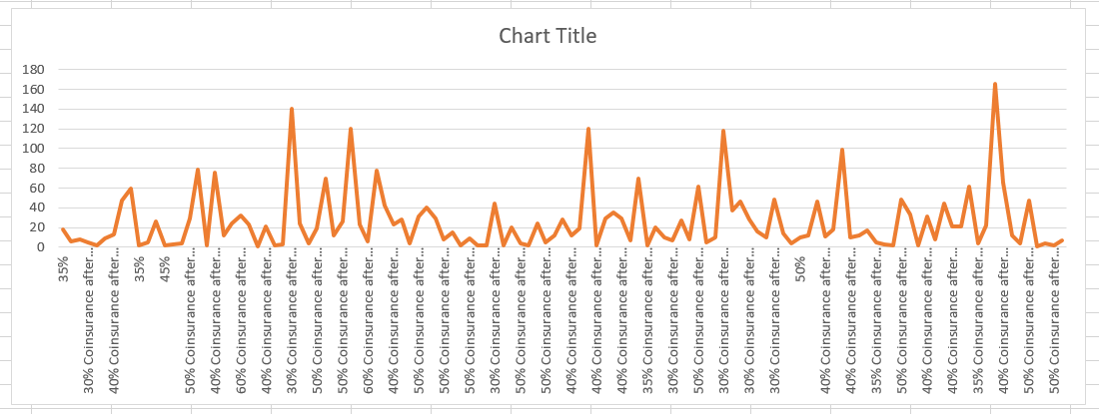
2014:
Notes:
Here this graph gives the details for year 2014 and how the Co Insurance values are varying for each state.

Slide 31
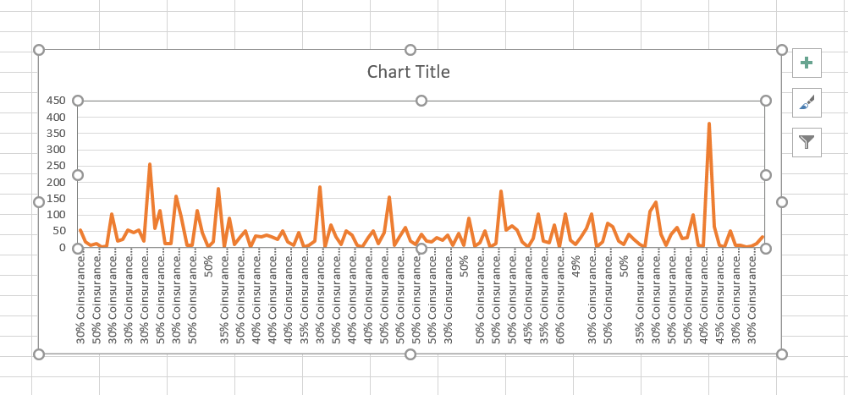
2015:
Notes:
Here this graph gives the details for year 2015 and how the Co Insurance values are varying for each state.
One thing we can observe is the decreasing trend for some of the Co Insurance levels and increase for some of the Co Insurance levels

Slide 32
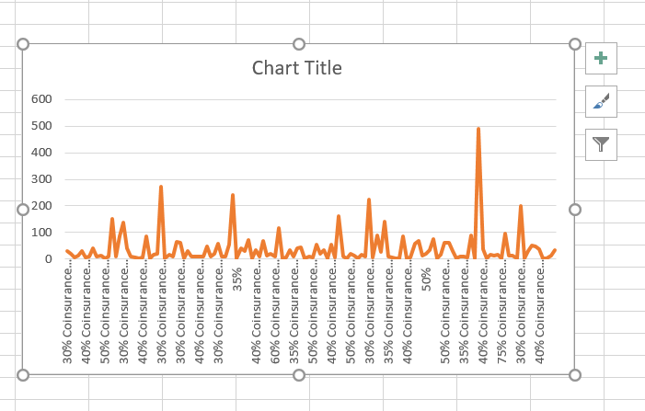
2016:
Notes:
Here this graph gives the details for year 2016 and how the Co Insurance values are varying for each state.
One thing we can observe is the decreasing trend for some of the Co Insurance levels and increase for some of the Co Insurance levels

Slide 33
Plan Attributes:
Plandialysis <- sqldf("select * from planattributes where standardcomponentid in (select standardcomponentid from benefitcostsharingdialysis)")
colnames(plandialysis)
The max out of pocket is the amount of money that the family would have to pay before the insurance covers everything 100%.
Goal : To find out the trend followed in No Of Plan ID’s for the Plan level attribute: TEHBInnTier1FamilyMOOP for each business year and state code.
statdialysis1 <- sqldf("select businessyear, statecode,TEHBInnTier1FamilyMOOP, count(standardcomponentid) from plandialysistest group by businessyear, statecode,TEHBInnTier1FamilyMOOP ")
statdialysis2 <- sqldf("select businessyear, TEHBInnTier1FamilyMOOP, count(standardcomponentid) from plandialysistest group by businessyear, TEHBInnTier1FamilyMOOP ")
statdialysis3 <- sqldf("select businessyear, TEHBInnTier1FamilyMOOP, count(standardcomponentid) as countofplanids from plandialysistest where TEHBInnTier1FamilyMOOP >0 group by businessyear, TEHBInnTier1FamilyMOOP ")
statdialysis4 <- sqldf("select businessyear, statecode,TEHBInnTier1FamilyMOOP, count(standardcomponentid) from plandialysistest where TEHBInnTier1FamilyMOOP >0 group by businessyear, statecode,TEHBInnTier1FamilyMOOP order by statecode, businessyear")
Notes:
In the previous slides we have shown on how the count of plans are varying based for different co Insurance levels.
And we just want to find the same details for different Maximum Out of Pocket levels.
We believe that Normally people will be choosing the plans based on Co Insurance levels , Co Pay Levels and the Maximum Out of Pocket for Medical and Drug EHB Benefits
plandialysis <- sqldf("select * from planattributes where standardcomponentid in (select standardcomponentid from benefitcostsharingdialysis)")
colnames(plandialysis)
Variable Name: TEHBInnTier1FamilyMOOP
Variable Definition: The dollar amount of the tier 1 in network, family out-of-pocket cost limit for medical and drug EHB benefits
Variable Label: Maximum Out of Pocket for Medical and Drug EHB Benefits (Total), In Network (Tier 1), Family
Field Name from Data Source: Maximum Out of Pocket for Medical and Drug EHB Benefits (Total), In Network (Tier 1), Family
Comments: This field is only applicable for plans with combined medical and drug MOOP limits; this field will be blank for dental
unique(planattributestest$MedicalDrugDeductiblesIntegrated)
unique(planattributes$PlanType)
unique(planattributes$MarketCoverage)
unique(planattributes$TEHBOutOfNetFamilyMOOP)
plandialysistest <- plandialysis[,c(2,3,4,5,9,59,32,89,159,60,61,62,63,64,101,102,103,105,108,109,110,111,113,114,115,117,118,134,135)]
colnames(plandialysistest)
plandialysistest <- plandialysistest[,c(4,29,3,28,27,26,23,24,1,2,6,7,8,9,15)]
colnames(plandialysistest)
unique(plandialysistest$TEHBInnTier1FamilyMOOP)
## removing dollar symbol and comma
plandialysistest$TEHBInnTier1FamilyMOOP<- gsub(',', '', plandialysistest$TEHBInnTier1FamilyMOOP)
plandialysistest$TEHBInnTier1FamilyMOOP<- gsub('\\$', '', plandialysistest$TEHBInnTier1FamilyMOOP)
unique(plandialysistest$TEHBInnTier1FamilyMOOP)
plandialysistest <- subset(plandialysistest, (plandialysistest$TEHBInnTier1FamilyMOOP != "Not Applicable"))
unique(plandialysistest$TEHBInnTier1FamilyMOOP)
statdialysis1 <- sqldf("select businessyear, statecode,TEHBInnTier1FamilyMOOP, count(standardcomponentid)
from plandialysistest
group by businessyear, statecode,TEHBInnTier1FamilyMOOP ")
statdialysis2 <- sqldf("select businessyear, TEHBInnTier1FamilyMOOP, count(standardcomponentid)
from plandialysistest
group by businessyear, TEHBInnTier1FamilyMOOP ")
statdialysis3 <- sqldf("select businessyear, TEHBInnTier1FamilyMOOP, count(standardcomponentid) as countofplanids
from plandialysistest
where TEHBInnTier1FamilyMOOP >0
group by businessyear, TEHBInnTier1FamilyMOOP ")
statdialysis4 <- sqldf("select businessyear, statecode,TEHBInnTier1FamilyMOOP, count(standardcomponentid)
from plandialysistest
where TEHBInnTier1FamilyMOOP >0
group by businessyear, statecode,TEHBInnTier1FamilyMOOP
order by statecode, businessyear")
options(scipen=999)
year2014 <- subset(statdialysis3, (statdialysis3$BusinessYear == 2014))
for(i in 1: dim(year2014)[1])
{
year2014$percentoftotal[i] <- (((year2014$countofplanids[i])/ sum(year2014$countofplanids) ) * 100)
}
year2015 <- subset(statdialysis3, (statdialysis3$BusinessYear == 2015))
for(i in 1: dim(year2015)[1])
{
year2015$percentoftotal[i] <- (((year2015$countofplanids[i])/ sum(year2015$countofplanids) ) * 100)
}
statdialysis5 <- rbind(year2014,year2015)
## http://healthcoverageguide.org/reference-guide/coverage-types/plan-characteristics-and-types/
write.xlsx(statdialysis5,"A:/statdialysis5.xlsx")

Slide 34
year2014 <- subset(statdialysis3, (statdialysis3$BusinessYear == 2014))
for(i in 1: dim(year2014)[1])
{ year2014$percentoftotal[i] <- (((year2014$countofplanids[i])/ sum(year2014$countofplanids) ) * 100) }
year2015 <- subset(statdialysis3, (statdialysis3$BusinessYear == 2015))
for(i in 1: dim(year2015)[1])
{ year2015$percentoftotal[i] <- (((year2015$countofplanids[i])/ sum(year2015$countofplanids) ) * 100) }
statdialysis5 <- rbind(year2014,year2015)

Slide 35
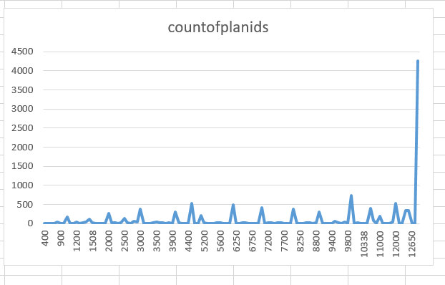
Year 2014:

Slide 36
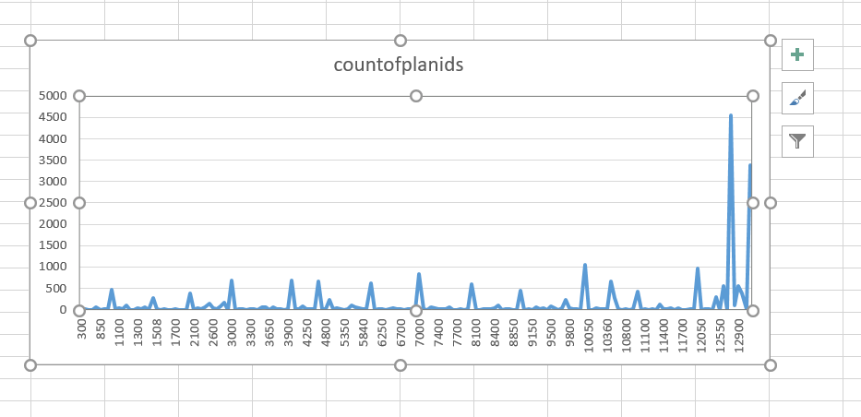
Year 2015:

Slide 37
Further analysis …
See if we can find any relations or rules for the counts Plans based on Co Insurance levels , Co Pay Levels and the Maximum Out of Pocket for Medical and Drug EHB Benefits
Thank You …

